Slide 1

Dr Jason Harris,
Professor of Corporate Law, Sydney
Law School
Michael Murray
Murrays Legal
Rebuilding Insolvency Law

Slide 2

Problems with the current system – there is not enough money to go round: it is insolvent

Slide 3
The economic reality of insolvency
ASIC Initial EXAD Report (former Sch B EX01) Series 3.3 (FY18-19-last available)
37% of reports estimated <$1 in assets; 79% <$50k in assets
78% of reports estimated asset deficiency of $1m or less; 68% deficiency >$50k <$1m
63% of reports said $0 owed to secured creditors
21% of reports noted outstanding employee entitlements (but 52% of reports noted outstanding superannuation)
32% reported suspected insolvent trading
92% of reports estimated 0c return for unsecured creditors (96.4% of reports estimated <11c)
  2.3% of reports estimated returns of 21c or more for unsecured creditors
18% of liquidator reports estimated $0 in remuneration (85% of liquidator reports estimated <$50k in remuneration)
ABS 8165.0, Counts of Australian businesses, including entries and exits, 20.5.22
Only 41% of businesses are incorporated
60 of all businesses have no employees
71% of those that do employ people, only employ 1-4 people
52% of businesses that survived between FY18-21 had <$200k in turnover

Slide 4
The economic reality of insolvency
AFSA: Annual Administration Statistics (FY20-21)
Only 16% of bankruptcies have a RT (84% OT)
  30% are business related
Only 16% of estates paid a dividend (all bankruptcies)
Of those, average rate of return was 11c/dollar
  1.6c/dollar for all bankruptcies
Debt agreements paid 55c/dollar (PIA paid 9.7c/dollar)
  Only 4.7% are business related

Slide 5

The insolvency narrative
‘There is often a message that creditors only get 11c in the dollar but if 85 per cent of companies have only less than $100,000 in assets and must pay the cost of external administrators, it sometimes promotes an undue expectations of returns’
Adrian Brown (former ASIC Insolvency Senior Executive Leader, www.smh.com.au 17.11.2015)
‘External administrations are focused on maximising the return to creditors, irrespective of the cost of the process or the effect on the business… Where businesses do need to be wound up, there is a concern that the cost of the process far outweighs any benefit to creditors, even where liabilities are small, and a business structure is simple.’
ASBFEO, Insolvency Practices Inquiry, July 2020

Slide 6

Rise of the zombies?
Data from https://publishednotices.asic.gov.au/ from August 2012-July 2021 reveals:
Voluntary deregistrations (s 601AA): 702,680 (or approx. 78,000 per year)
ASIC initiated deregistrations (s 601AB): 537,930 (or approx. 59,000 per year)

Slide 7
Challenges for the insolvency profession
Decline in work and declining numbers of practitioners
Increasing compliance costs
  Creditor information requests
  Fair Entitlement Guarantee recovery program actions (corporate)
ASIC Industry funding cost recovery (corporate)
Public expectation gap
  Insolvency practitioners as gatekeepers
    Lack of (ASIC) enforcement action
  Detailed investigation and reporting requirements: who pays for this?
  Large amounts of unfunded or underfunded work
  Inadequate or inefficient government support funding
Widespread creditor apathy
Largely unregulated pre-insolvency (untrustworthy) advisors
Insolvency administration gives rise to stigma and blame focus

Slide 8

Insolvency is not working well for MSMEs
  Need a better balance of public and private responsibilities
    Particularly in corporate insolvency
  Need to focus more on preventive regulation (facilitation and guidance)
  Rethink separation between personal and corporate insolvency
    Focus on business insolvency
    Rethink independence
    Rethink regulatory framework
Insolvency regulation is achieving poor outcomes
  Need to rethink ‘blame and shame’ focus
  We can’t afford a ‘Rolls Royce’ system anymore
  Rethink legitimate and appropriate expectations of insolvency system

Slide 9
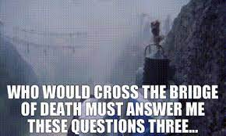
Questions of corporate lawyers I’ve always wanted to ask … (and get a good reply)
Why are we discussing this topic at all? Why did Australia not create a regulatory official receiver role at federation? What happened to the Companies Bill 1908 (Cth) and the Insolvency Bill 1908 (Cth)?
Why does company insolvency receive such attention, and directors so little sanction, when the reality of small business is either sole trader or blended assets and liabilities?
Why does corporate law have separate provisions for compulsory and voluntary appointments, which then impacts official receiver roles?

Slide 10

We need to rethink the insolvency law system before or in parallel with a wholesale review of the laws that are to operate within that system.

Slide 11
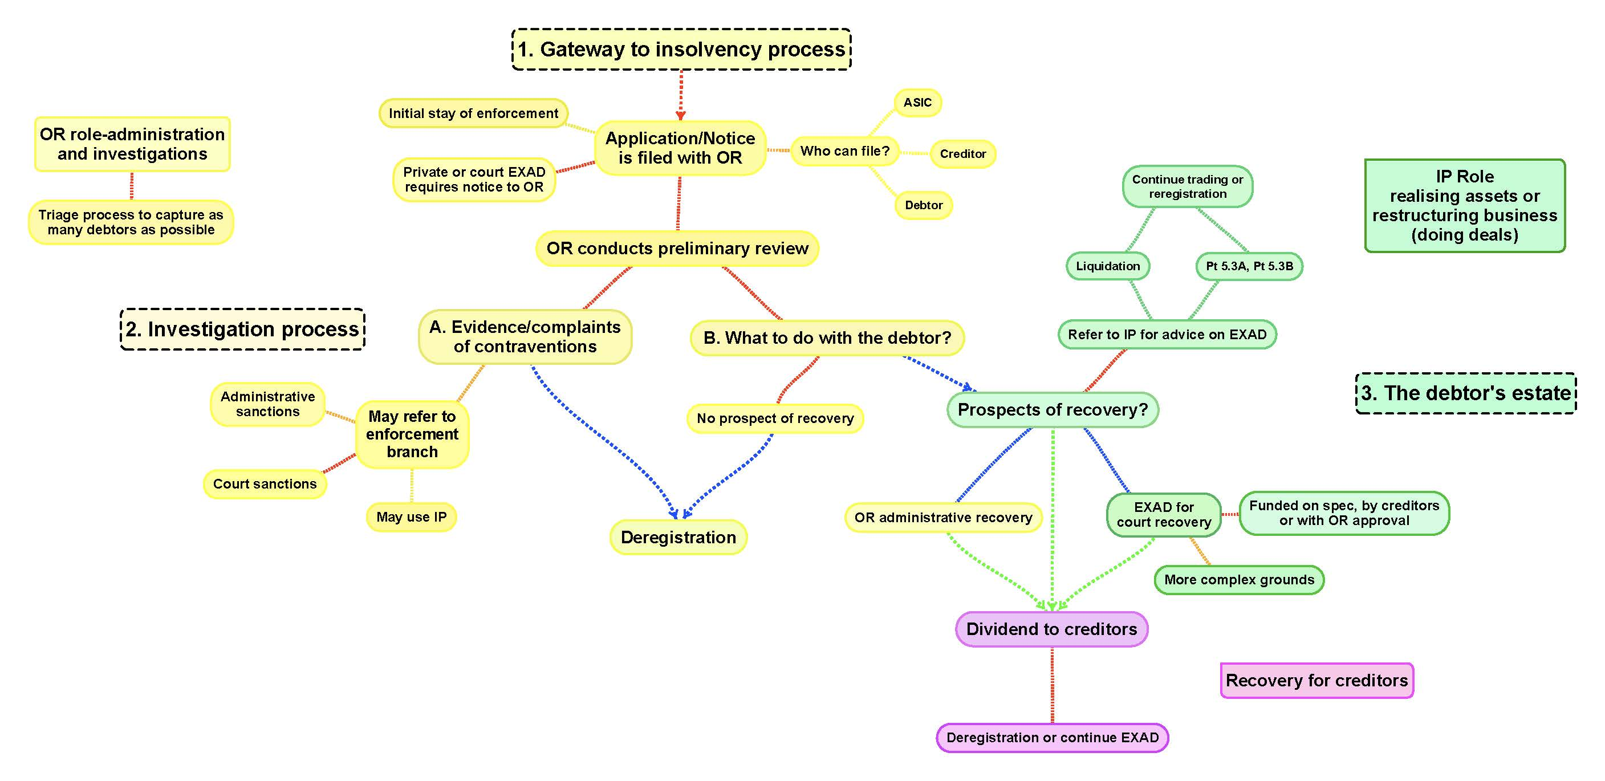

Slide 12
Other regulatory models
UK
Official Receiver is appointed as liquidator in court liquidations and in court ordered bankruptcies (may be replaced by creditors)
NZ
Official Assignee in Bankruptcy (no private trustees)
Licensed liquidators
Malaysia
Official Assignee in Bankruptcy
Official Receiver (or registered liquidator)
Singapore
Official Assignee in Bankruptcy (can be appointed if no private trustee)
Official Receiver in court liquidations (unless no registered liquidator appointed)
USA
US Trustee Service can act as trustee in bankruptcy for Ch 7 (liq/bankr), Ch 12 (farm debt) or Ch 13 (individual bankruptcy) if no private trustee is willing
Trustees are paid on a commission basis (percentage of distributions)

Slide 13
“Insanity is doing the same thing over and over and expecting different results.”

